Slide 1
COMP 3500 Introduction to Operating Systems Paging: Basic Method
Dr. Xiao Qin
Auburn University http://www.eng.auburn.edu/~xqin
xqin@auburn.edu
Slides are adopted and modified from Drs. Silberschatz, Galvin, and Gagne
Notes:
45 Minutes: Slides 1-12

Slide 2
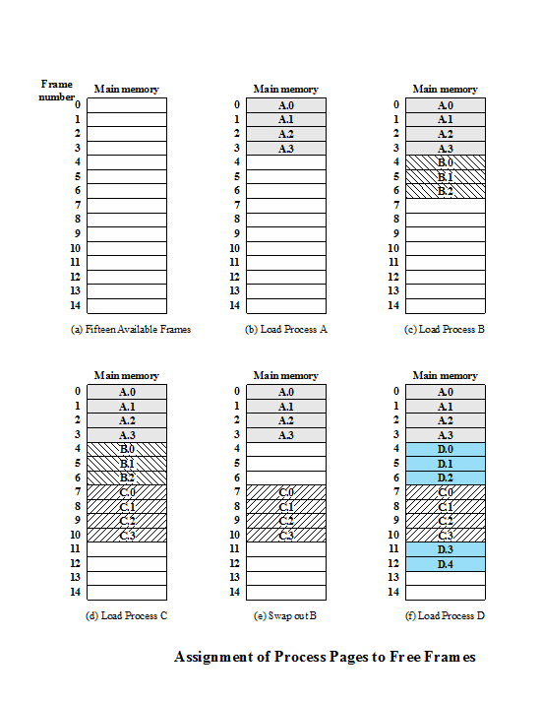
Review: Paging
Partition memory into equal fixed-size chunks that are relatively small
Process is also divided into small fixed-size chunks of the same size
Notes:
Physical address space of a process can be noncontiguous; process is allocated physical memory whenever the latter is available
Avoids external fragmentation
Avoids problem of varying sized memory chunks
Divide physical memory into fixed-sized blocks called frames
Size is power of 2, between 512 bytes and 16 Mbytes
Divide logical memory into blocks of same size called pages
Keep track of all free frames
To run a program of size N pages, need to find N free frames and load program
Set up a page table to translate logical to physical addresses
Backing store likewise split into pages
Still have Internal fragmentation
Both unequal fixed-size and variable-size partitions are inefficient in the use of memory; the former results in internal fragmentation, the latter in external fragmentation. Suppose, however, that main memory is partitioned into equal fixed-size chunks that are relatively small, and that each process is also divided into small fixed-size chunks of the same size. Then the chunks of a process, known as pages , could be assigned to available chunks of memory, known as frames , or page frames. We show in this section that the wasted space in memory for each process is due to internal fragmentation consisting of only a fraction of the last page of a process. There is no external fragmentation.

Slide 3
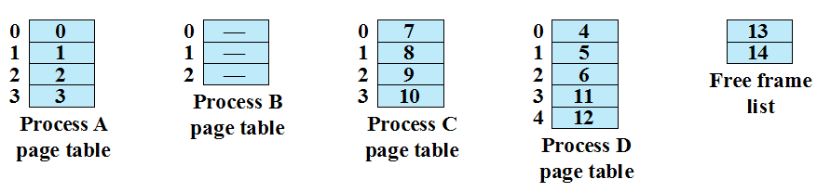
Review: Page Table
Maintained by operating system for each process
Contains the frame location for each page in the process
Processor must know how to access for the current process
Used by processor to produce a physical address
Notes:
Page Table Examples

Slide 4
Ex1: How to use a page table to perform logical-to-physical address translations?

Slide 5
Logical-to-Physical Address Translation Scheme
Address generated by CPU is divided into:
Page number (p) – used as an index into a page table which contains base address of each page in physical memory
Page offset (d) – combined with base address to define the physical memory address that is sent to the memory unit
For given logical address space 2^{m} and page size 2^{n}

Slide 6
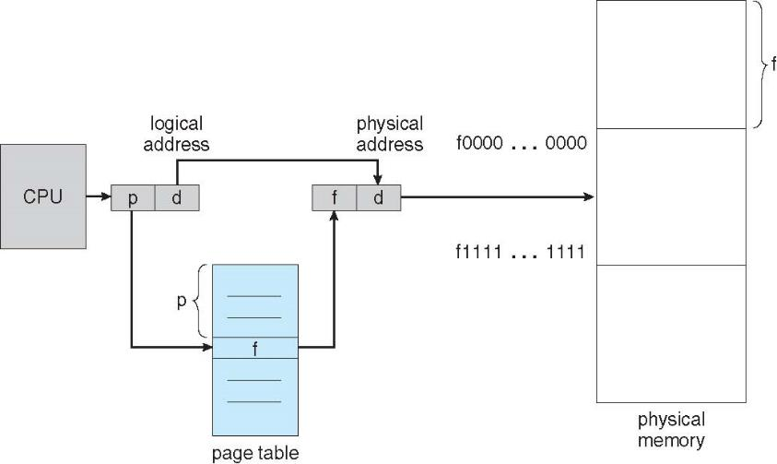
Logical-to-Physical Address Translations

Slide 7
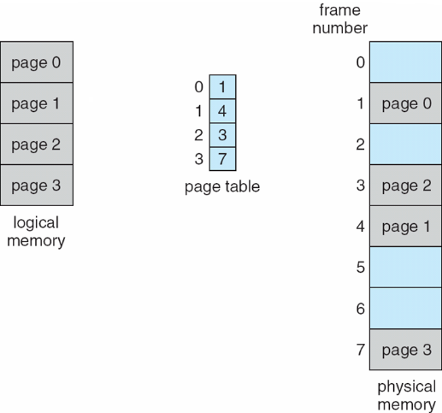
Ex2: Please fill the following page table up.

Slide 8
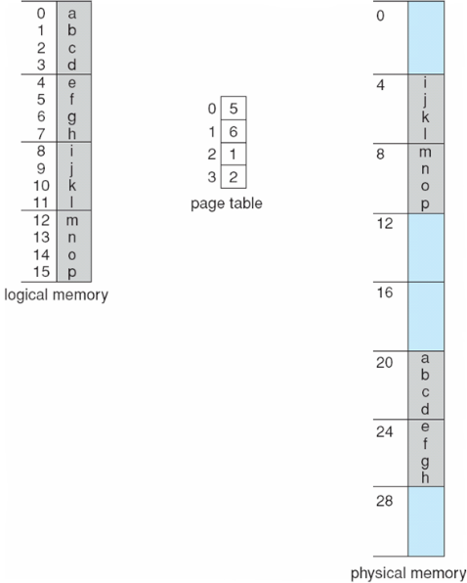
Ex3: A Paging Example
What is the size of physical memory?
What is the page size?
How many bits are used as an index into a page table?
How many bits are used for page offset?
Notes:
n=2 and m=4 32-byte memory and 4-byte pages

Slide 9
Ex4: Calculating Internal Fragmentation
Page size = 2,048 bytes
Process size = 72,766 bytes
How many pages are there in this process?
How many bytes are there in the last page?
What is the internal fragment?
What is the worst case fragmentation?
What is the average fragmentation?
Notes:
Explain what is internal fragment?
Example: page size 8 bytes. 5 bytes are used in a page. Then the internal fragment is 8-5=3 bytes (unused space).
Process view and physical memory now very different
By implementation process can only access its own memory

Slide 10
Ex5: Smaller frame size the better? Why?
Are small frame sizes desirable?
Small frame size: small fragment
Small frame size: large table size
each page table entry takes memory to track
Page sizes growing over time
Solaris supports two page sizes – 8 KB and 4 MB
Notes:
Small frame size -> small fragment
Small frame size -> large table size

Slide 11
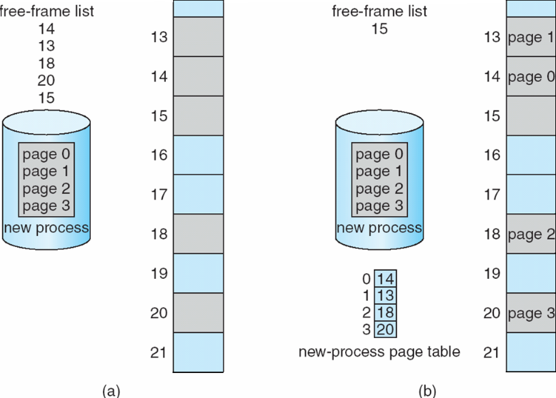
Ex6: What is the free-frame list after allocation?
Before allocation
After allocation
Notes:
Managing Free Frames

Slide 12
Ex7: Two registers to support paging
Where should we keep page tables?
Where does the Page-table base register (PTBR) point at?
The Page-table length register (PTLR) indicates size of the page table. Why the Page-table length register (PTLR) is important?

Slide 13
Ex8: Memory Accesses in the Paging Scheme
To load an instruction or data from main memory, how many memory accesses are required in the paging scheme?
two memory accesses
One for the page table and one for the data / instruction
What is the problem with respect to memory access?
The two memory access problem can be solved by the use of a special fast-lookup hardware cache called associative memory or translation look-aside buffers (TLBs)

Slide 14
Translation Look-aside Buffers (TLBs)
Some TLBs store address-space identifiers (ASIDs) in each TLB entry – uniquely identifies each process to provide address-space protection for that process
Otherwise need to flush at every context switch
TLBs typically small (64 to 1,024 entries)
On a TLB miss, value is loaded into the TLB for faster access next time
Replacement policies must be considered
Some entries can be wired down for permanent fast access

Slide 15
Parallel Searching the TLB
Associative memory – parallel search
Address translation (p, d)
If p is in associative register, get frame # out
Otherwise get frame # from page table in memory

Slide 16
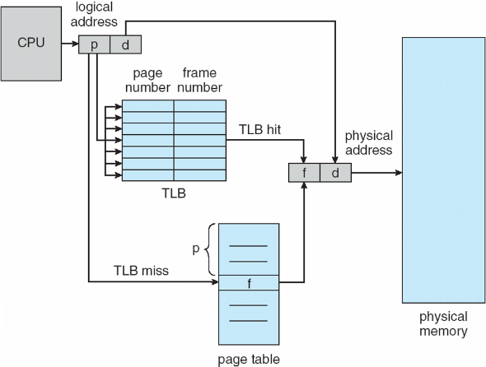
Paging Hardware With TLB

Slide 17
Summary
What is a page table?
logical-to-physical address translations
Internal Fragmentation
Translation Look-aside Buffers (TLBs)
Notes:
Explain what is internal fragment?
Example: page size 8 bytes. 5 bytes are used in a page. Then the internal fragment is 8-5=3 bytes (unused space).
Process view and physical memory now very different
By implementation process can only access its own memory

